Slide 1
Orange County Contracting Academy July 12, 2024 Sheena Ferguson, Manager
Business Development Division

Slide 2
Agenda
Mission
Programs & Services
Common Bidding Mistakes
Future Program Enhancements
Questions
2

Slide 3
Agenda
Mission
Programs & Services
Common Bidding Mistakes
Future Program Enhancements
Questions
3

Slide 4
Mission
To promote the participation in and award of contracts to minority and women business enterprises in accordance with the M/WBE Ordinance.
4

Slide 5
Agenda
Mission
Programs & Services
Common Bidding Mistakes
Future Program Enhancements
Questions
5

Slide 6
Program & Services
Certification of Minority and Women-owned Businesses in the Orlando MSA
Registration of Service-Disabled Veteran (SDV)
Businesses
6

Slide 7
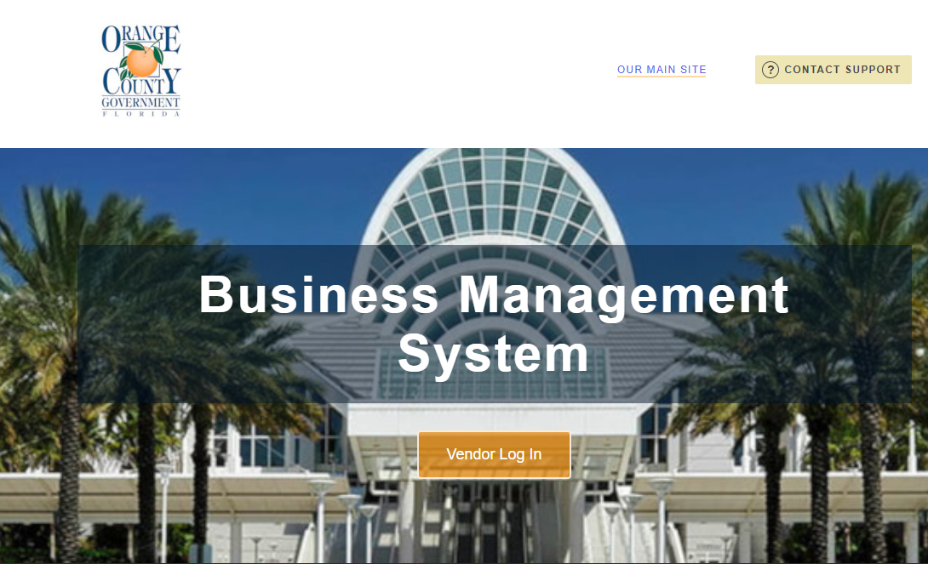
Programs & Services
On-line certification using B2GNOW
https://ocfl.diversitycompliance.com/?TN=ocfl
7

Slide 8
Programs & Services
Review & Determine M/WBE Utilization Goal
Participate in Pre-bid/Pre-proposal and Pre-Construction /Kickoff meetings
Evaluate bids/proposals for M/WBE compliance including Good Faith Effort, Registered Service-Disabled Veteran Utilization
Contract Compliance and Monitoring projects with M/WBE participation
Non-compliance letters sent for not meeting M/WBE goals and/or Non-Payment Issues
8

Slide 9
Programs & Services
M/WBE Contract Compliance Goals
25% Construction
27% Professional Services
24% Services
10 % Goods
Payment Verification
M/WBE Mediation
9

Slide 10
Programs & Services
Execute M/WBE subcontractor prior to contract award
Conduct site visits - certification & projects
Participate as a voting member for all Procurement meetings.
Review all task authorizations for M/WBE
Compliance.
4
10

Slide 11
Programs & Services
Compliance Reporting (submitted on-line)
Construction (Monthly Reporting)
Goods & Services (Quarterly Reporting)
Professional Services (Quarterly Reporting)
Audits conducted to determine overall M/WBE participation.
M/WBE Utilization Report
M/WBE Utilization Report reviewed monthly
with M/WBE Advisory Committee
11

Slide 12
Programs & Services
Educational workshops
Certification
(Held the second Monday
of each month from 2-4 PM)
12

Slide 13
Programs and Services
Educational workshops
How to do Business with
Orange County
(Held the third Monday
of each month from
10-12 noon)
13

Slide 14
Programs and Services
Educational workshops
Good Faith Effort Open Forum
(Held the first Monday of
each month from 4-5 PM)
Presentation on website
https://www.ocfl.net/VendorServices/MinorityVendors.aspx
14

Slide 15
Programs and Services
Educational workshops
Community Partner
Topics vary (past topics, insurance/
bonding, reviewing, Legal documents,
Estimating, Effective Joint Ventures,
How to become a successful business,
Managing Business Credit, Marketing)
Held Quarterly
15

Slide 16
Agenda
Mission
Programs & Services
Common Bidding Mistakes
Future Program Enhancements
Questions
16

Slide 17
Common Bidding Mistakes
Automated forms not completed in their entirety or correctly.
2. M/WBE’s are listed for scope of services for which they are not
certified.
3. M/WBE firms are not certified by Orange County.
17

Slide 18
Common Bidding Mistakes
4. Construction M/WBE goals are not achieved and documents
illustrating efforts made to achieve the goals (Good Faith Effort)
are not submitted.
5. For FDOT funded projects, bidders do not complete the required
Disadvantage Business Enterprise (DBE) forms- such as the
Bidder Opportunity Listing
18

Slide 19
Agenda
Mission
Programs & Services
Common Bidding Mistakes
Future Program Enhancements
Questions
16

Slide 20
Future Program Enhancements
Disparity Study was completed in 2023, by Griffin & Strong, PA
Recommendations included
Small Business Enterprise
Reciprocal Certification
Ordinance Enhancements
19

Slide 21
Agenda
Mission
Programs & Services
Common Bidding Mistakes
Future Program Enhancements
Questions
16

Slide 22
Questions? BusinessDevelopment@ocfl.net https://www.ocfl.net/VendorServices/MinorityVendors.aspx
Business Development Division
Orange County Contracting Academy

